Slide 1
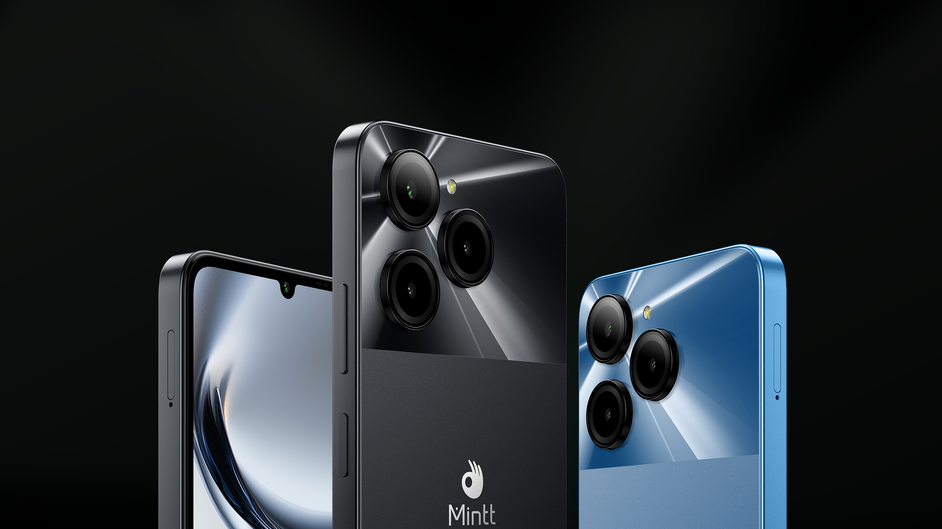
COOLMINTT X9
Dare to Live Life Proudly
6.745" HD+ Powered by T606 50MP Rear Camera

Slide 2
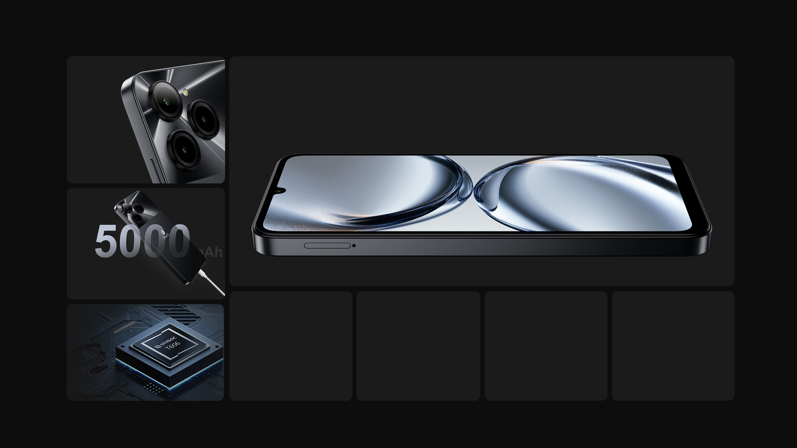

6.745" HD+ 90Hz
Waterdrop Display
50MP
Rear
Camera
18W Type-C Charging
T606
Octa-core,
1.6GHz
8MP
Front Camera
6GB+128GB
Android U
NFC

Slide 3
Appearance

Slide 4

More Space to Explore
The 6.745-inch HD+ screen provides you with a wide and clear field of view. Whether you are browsing the web or watching videos, the high-definition picture quality can show every detail, and the colors are rich and realistic, making you feel immersed in it. The 90Hz high refresh rate further improves the smoothness of operation. Whether you are sliding the interface, switching applications or watching dynamic content, you can feel the silky smooth visual experience.
6.745" HD+
91%
Screen Ratio
20:9
Aspect Ratio
1600*720
High Definition

Slide 5
Performance

Slide 6

Power Up Your Performance
With its octa-core architecture and high-performance processor, the T606 platform ensures a smooth, stutter-free operating experience even when multitasking, HD gaming, and complex applications are running. It adopts advanced manufacturing technology, which not only improves the computing speed, but also significantly reduces power consumption, giving your device longer battery life.
up to
1.6GHz
6GB
RAM
128GB
ROM

Slide 7


Stay Powered Up All Day
9V2A, Type-C
with 5000mAh Battery and 18W Fast Charging
The 5000mAh large-capacity battery can meet your high-intensity use needs throughout the day. Whether you are playing games for a long time, watching TV series, or communicating frequently, you don’t have to worry about insufficient power. The 18W fast charging technology takes the battery life experience to a new level. It only takes a short charging time to quickly restore power, ensuring that your device is always in the best condition.

Slide 8

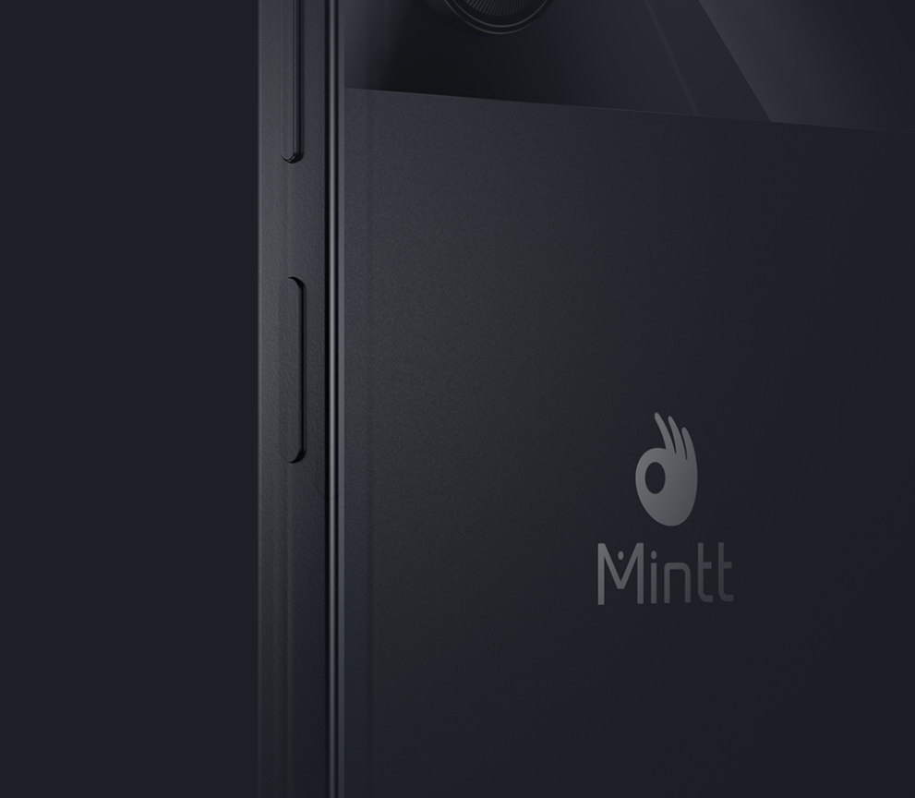
Unlock Your Wonderful Adventure
Face Unlock
at One Glance
Side-mounted
Fingerprint Unlock

Slide 9


NFC Inside:
Tap, Pay, and Connect Effortlessly
With the built-in NFC function, you can easily make quick payments. You no longer need to carry a cumbersome wallet. Just bring your phone close to the payment terminal to complete various payment operations such as shopping and riding. At the same time, NFC technology also supports fast connection of smart devices, such as wireless headphones and speakers, which can be connected by touch, making your smart life smoother and more enjoyable.

Slide 10
Camera configuration

Slide 11
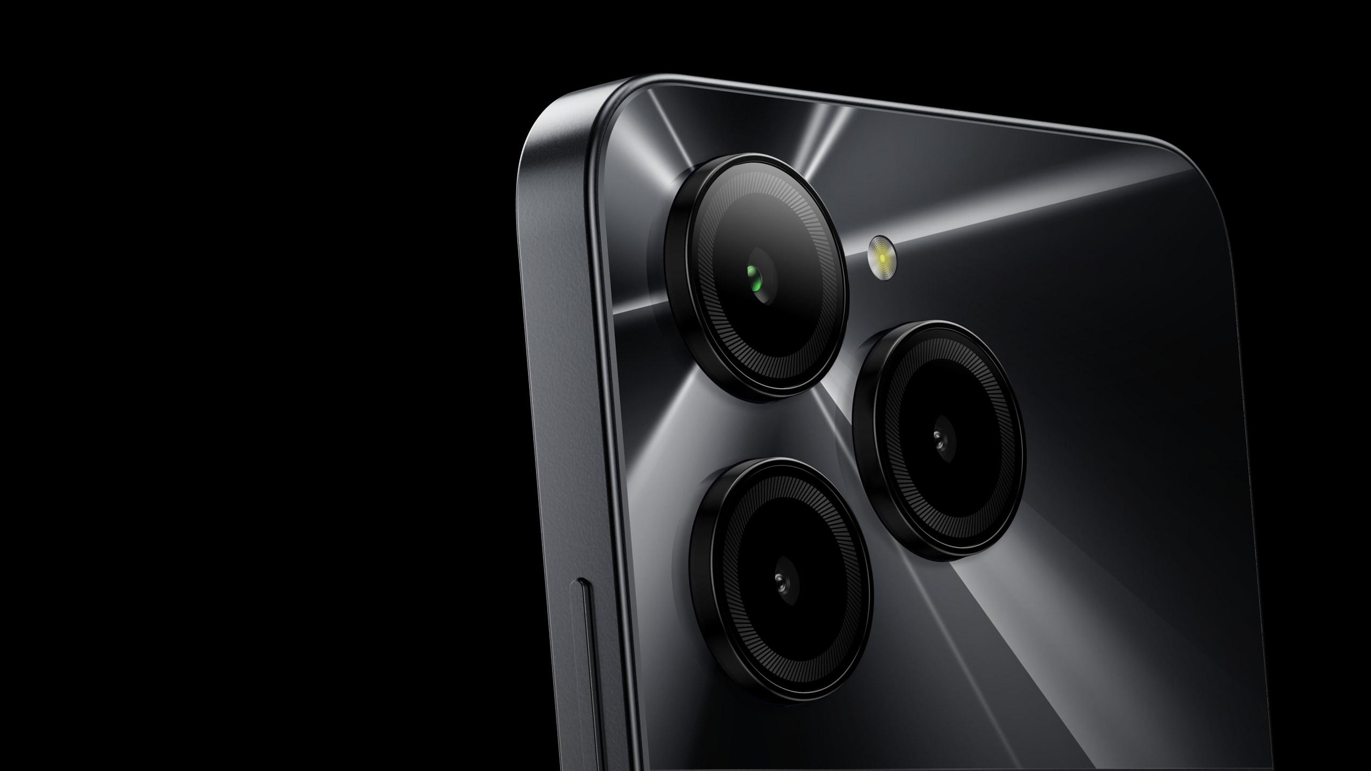
Unleash Every Detail
with 50MP Camera
Ultra-high resolution and precise detail capture make every frame of the picture appear fine and reproduce every detail of reality. Combined with advanced image processing algorithms, this camera can provide excellent performance in various lighting conditions, from bright sunlight to faint night scenes, and can take colorful, delicate and clear photos.

Slide 12


Capture Your True Beauty, Anytime, Anywhere
with 8MP Front Camera
This 8MP front camera not only has HD resolution to capture more details for clearer and more stunning selfies, but also integrates advanced portrait optimization technology. Whether you are outdoors in the sun or in a softly lit indoor environment, it can intelligently adjust the light and color to ensure that your face always looks its best.
The display pictures are simulated images,
which are only used for function description purposes.

Slide 13
Camera key features

Slide 14

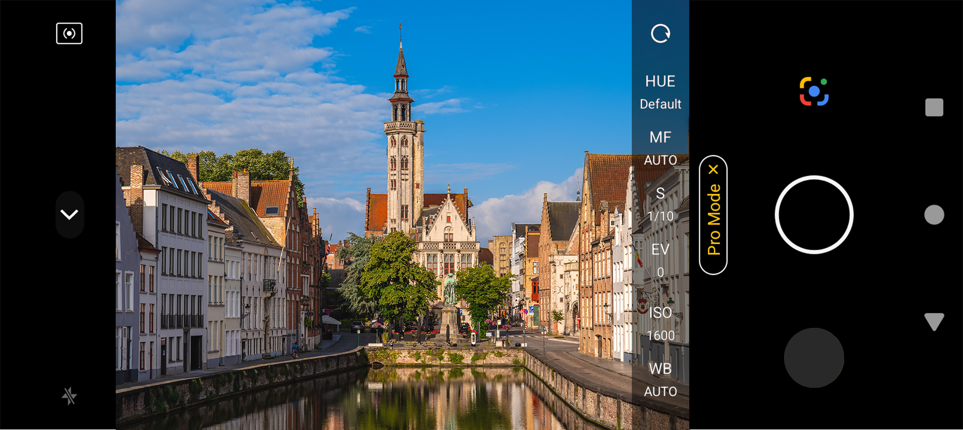
Pro Mode
Pro mode offers you adjustable parameters adjustment, easy to frame the views even in different scenes, delivering a professionals-like shooting experience.
The display pictures are simulated images,
which are only used for function description purposes.

Slide 15













Differentiate the Style of Your Life
The camera equipped with AI scene recognition function can automatically detect and optimize a variety of shooting environments, whether it is food, scenery or portraits, it can present the best results with one click.

Slide 16

Night Master
Whether it's a city nightscape, the suburbs under the stars, or a candlelight dinner, this camera can capture rich details and natural colors to reproduce the charming charm of the night.
On
Off

Slide 17

Time Lapse
The time-lapse function allows you to condense a long period of change into a short video, using images to record natural wonders such as the blooming and falling of flowers, the rising and setting of the sun and the moon, showing the magnificence and delicacy of the passage of time.

Slide 18

Slow Motion
The fast-moving moments are delicately displayed, allowing every wonderful moment to be prolonged, from the splashing water to the dancing hair, all are clearly visible.

Slide 19




8MP Front Camera
Whether in a dim environment or under the bright night sky, Night View mode combines the Blurring function with a variety of creative filters to capture every detail, so that your photos always remain clear and beautiful.
Beauty
Night View
Filters
Blurring

Slide 20
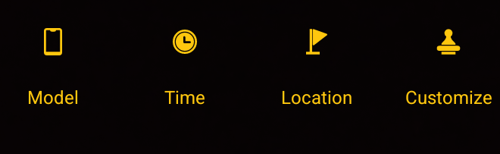

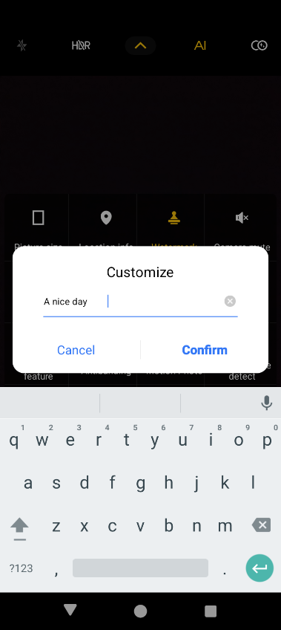

Customized Watermark
Edit the watermark with your mood, help you record every bit of daily life.
COOLMINTT X9 ·A nice day
2024.09.13.16:31
The display pictures are simulated images,
which are only used for function description purposes.

Slide 21

HDR
It can capture more details in scenes with strong light contrast. Through multi-frame synthesis technology, HDR shooting can balance the exposure in the same picture, avoid overexposure and underexposure problems, ensure that each part achieves the ideal brightness and contrast, and make the photos more vivid and layered.
The display pictures are simulated images,
which are only used for function description purposes.

Slide 22

Panorama
The panoramic shooting mode is easy to operate and can be easily turned on with one button. Just move the camera slowly to get magnificent panoramic photos. It is suitable for creative shooting in various scenes.

Slide 23

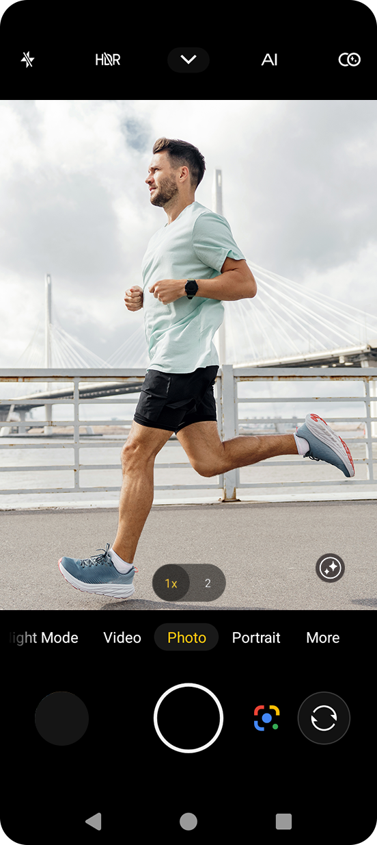
Long Press The Shutter
Freely adjust continuous shooting and short video recording

Slide 24




Intelligent Scan
The camera will mark the QR code, barcode, etc. in the scan box, making it easier to scan.

Slide 25

Smoother, Smarter and more Power-saving

Slide 26
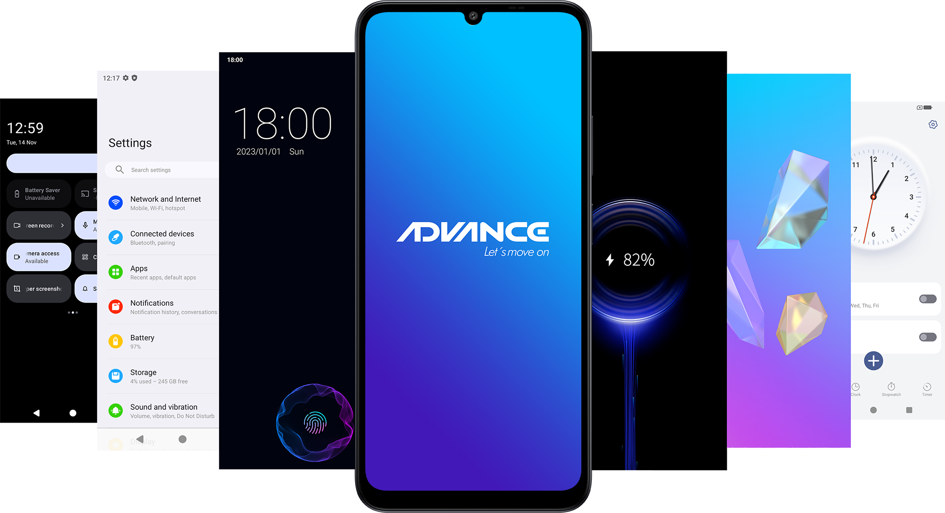
10+Module Customization

Slide 27

Smoother, Smarter and more Power-saving
30+ Special Features for Your Convenience
Unified and standardized design, rigorous detail polishing, for more consistent visual experience.

Slide 28
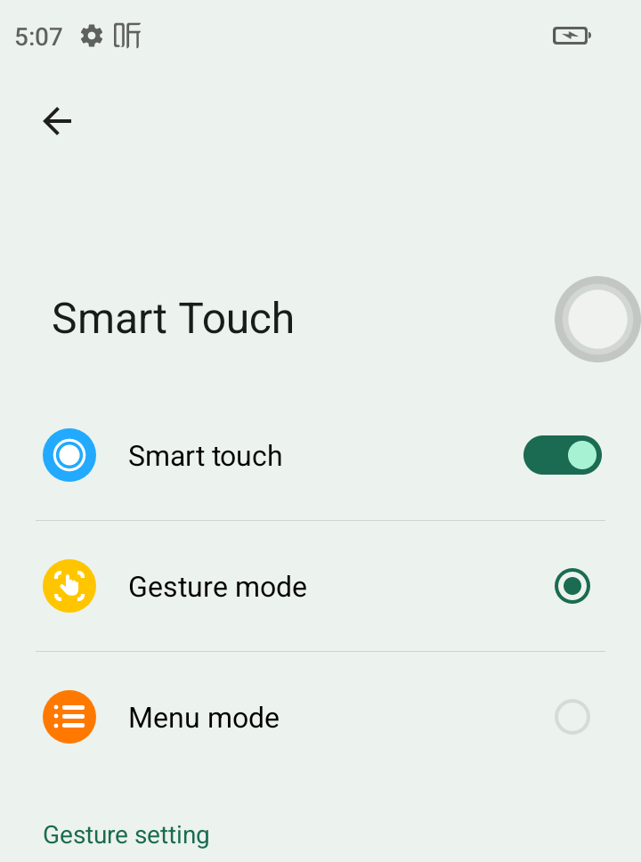
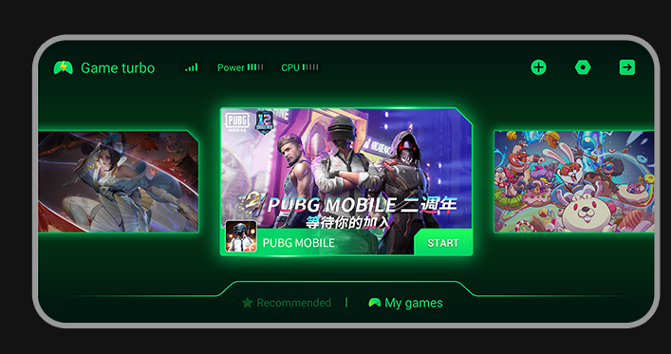
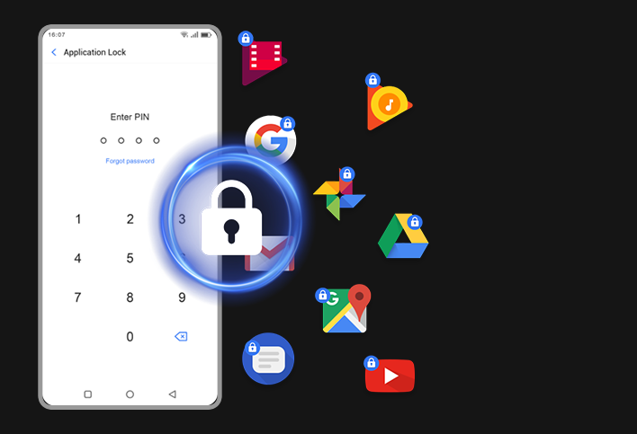

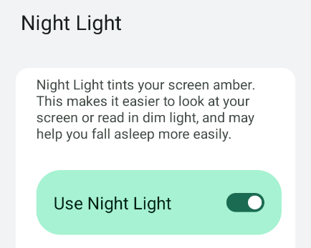
Game Acceleration
Increase the game progress by increasing the core and frequency.
Smart touch
The floating button opens shortcut functions for easy one-handed operation.
Night light
Make it easier to look at your screen or read in dim light, and may help you fall asleep more easily.
Lock the apps
Protect your privacy

Slide 29

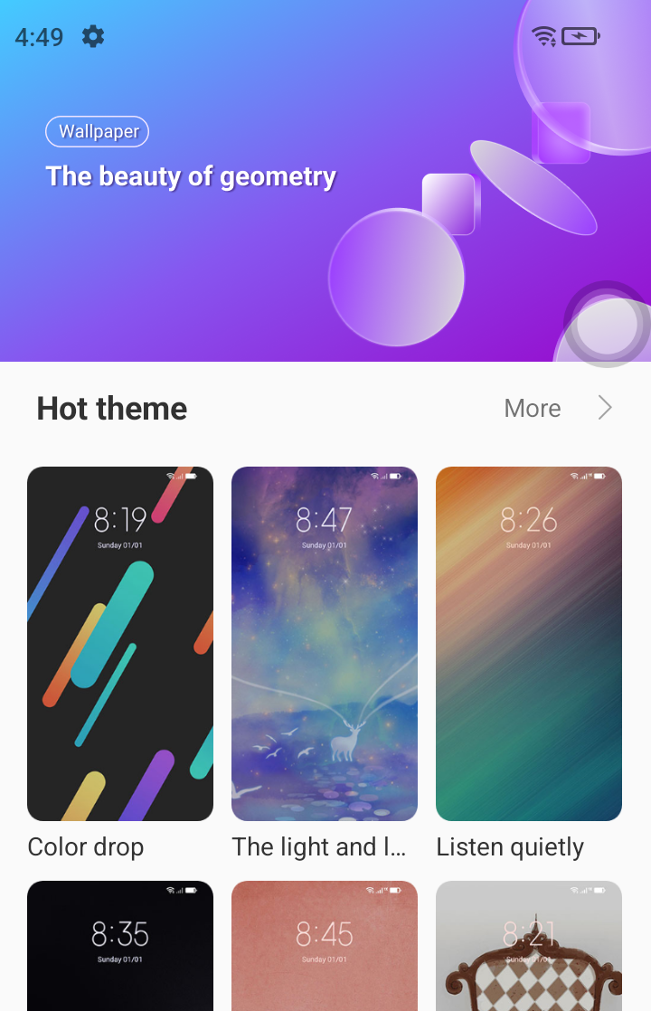
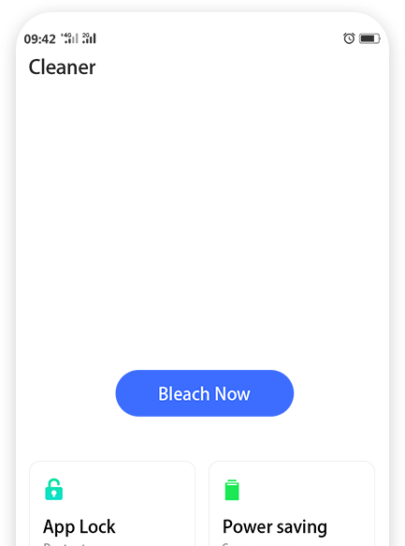

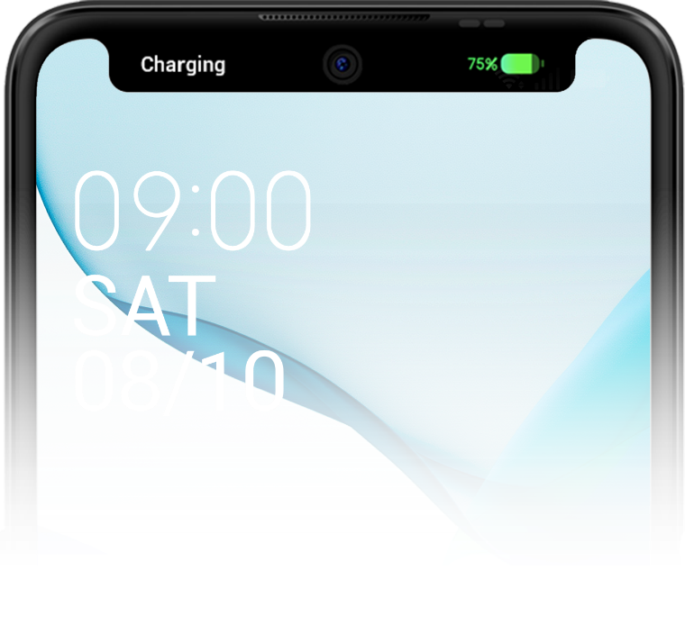
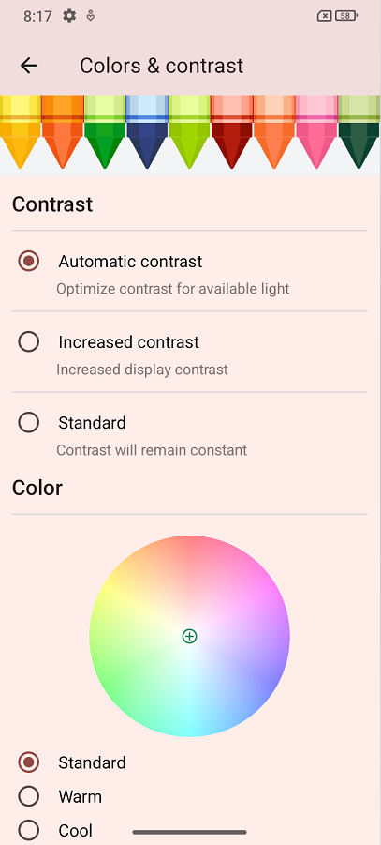
Listening Mode
Rich Theme Store
Cleaner
The listening mode developed for the popular app YouTube can continue to listen in the form of sound when the App returns to the background or the screen is off.
Make your phone less "burdened" and operate more smoothly
To choose or customize special color and element.
Dynamic Island
Customized color temperature adjustment
Innovative design for the punch-hole screen, which can be applied in seven high-frequency scenarios: call, music, sound status, timer, radio, charging, voice recorder.
Freely adjust the temperature of the screen

Slide 30
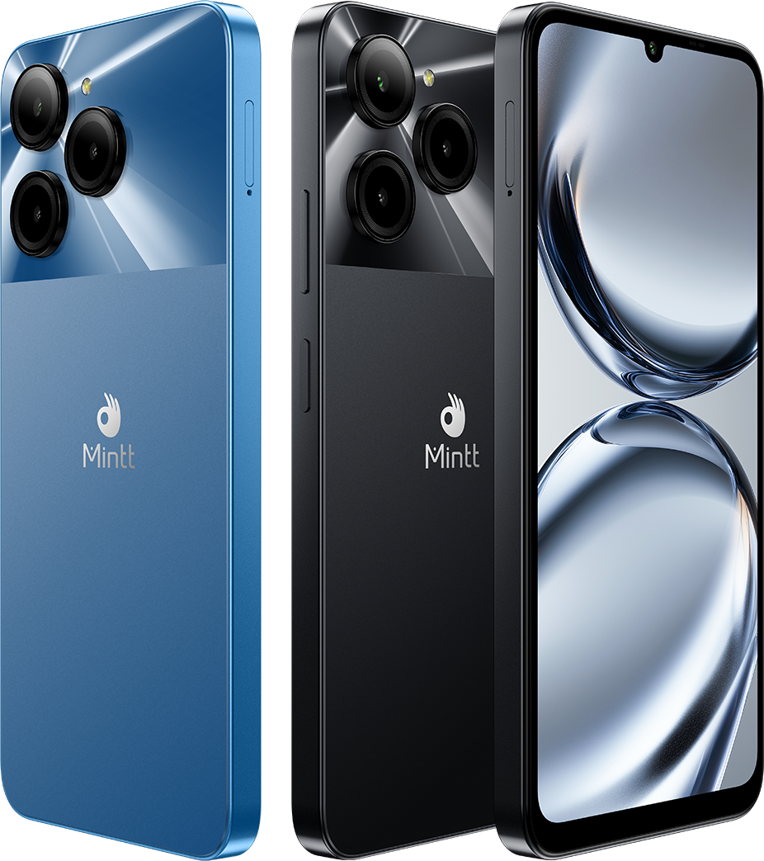
COOLMINTT X9 Specifications
Display | 6.745" HD+ 1600*720, 90Hz
Battery | 5000mAh
Charge | 9V2A, Type-C
Camera | 8MP Front Camera 50MP Rear Camera
Processor | T606 Octa-Core, 1.6GHz
Memory | 6GB+128GB
System | Android U
Network | 4G, nano+nano+TF
Color | Black, Blue
Dimensions | 164.5*76*8.95mm
Network | GSM：2/3/5/8 WCDMA: 1/2/5/8 FDD: 1/2/3/5/7/8/20/28AB TDD: 38/40/41
Others | NFC

Slide 31
Thank you

