Slide 1
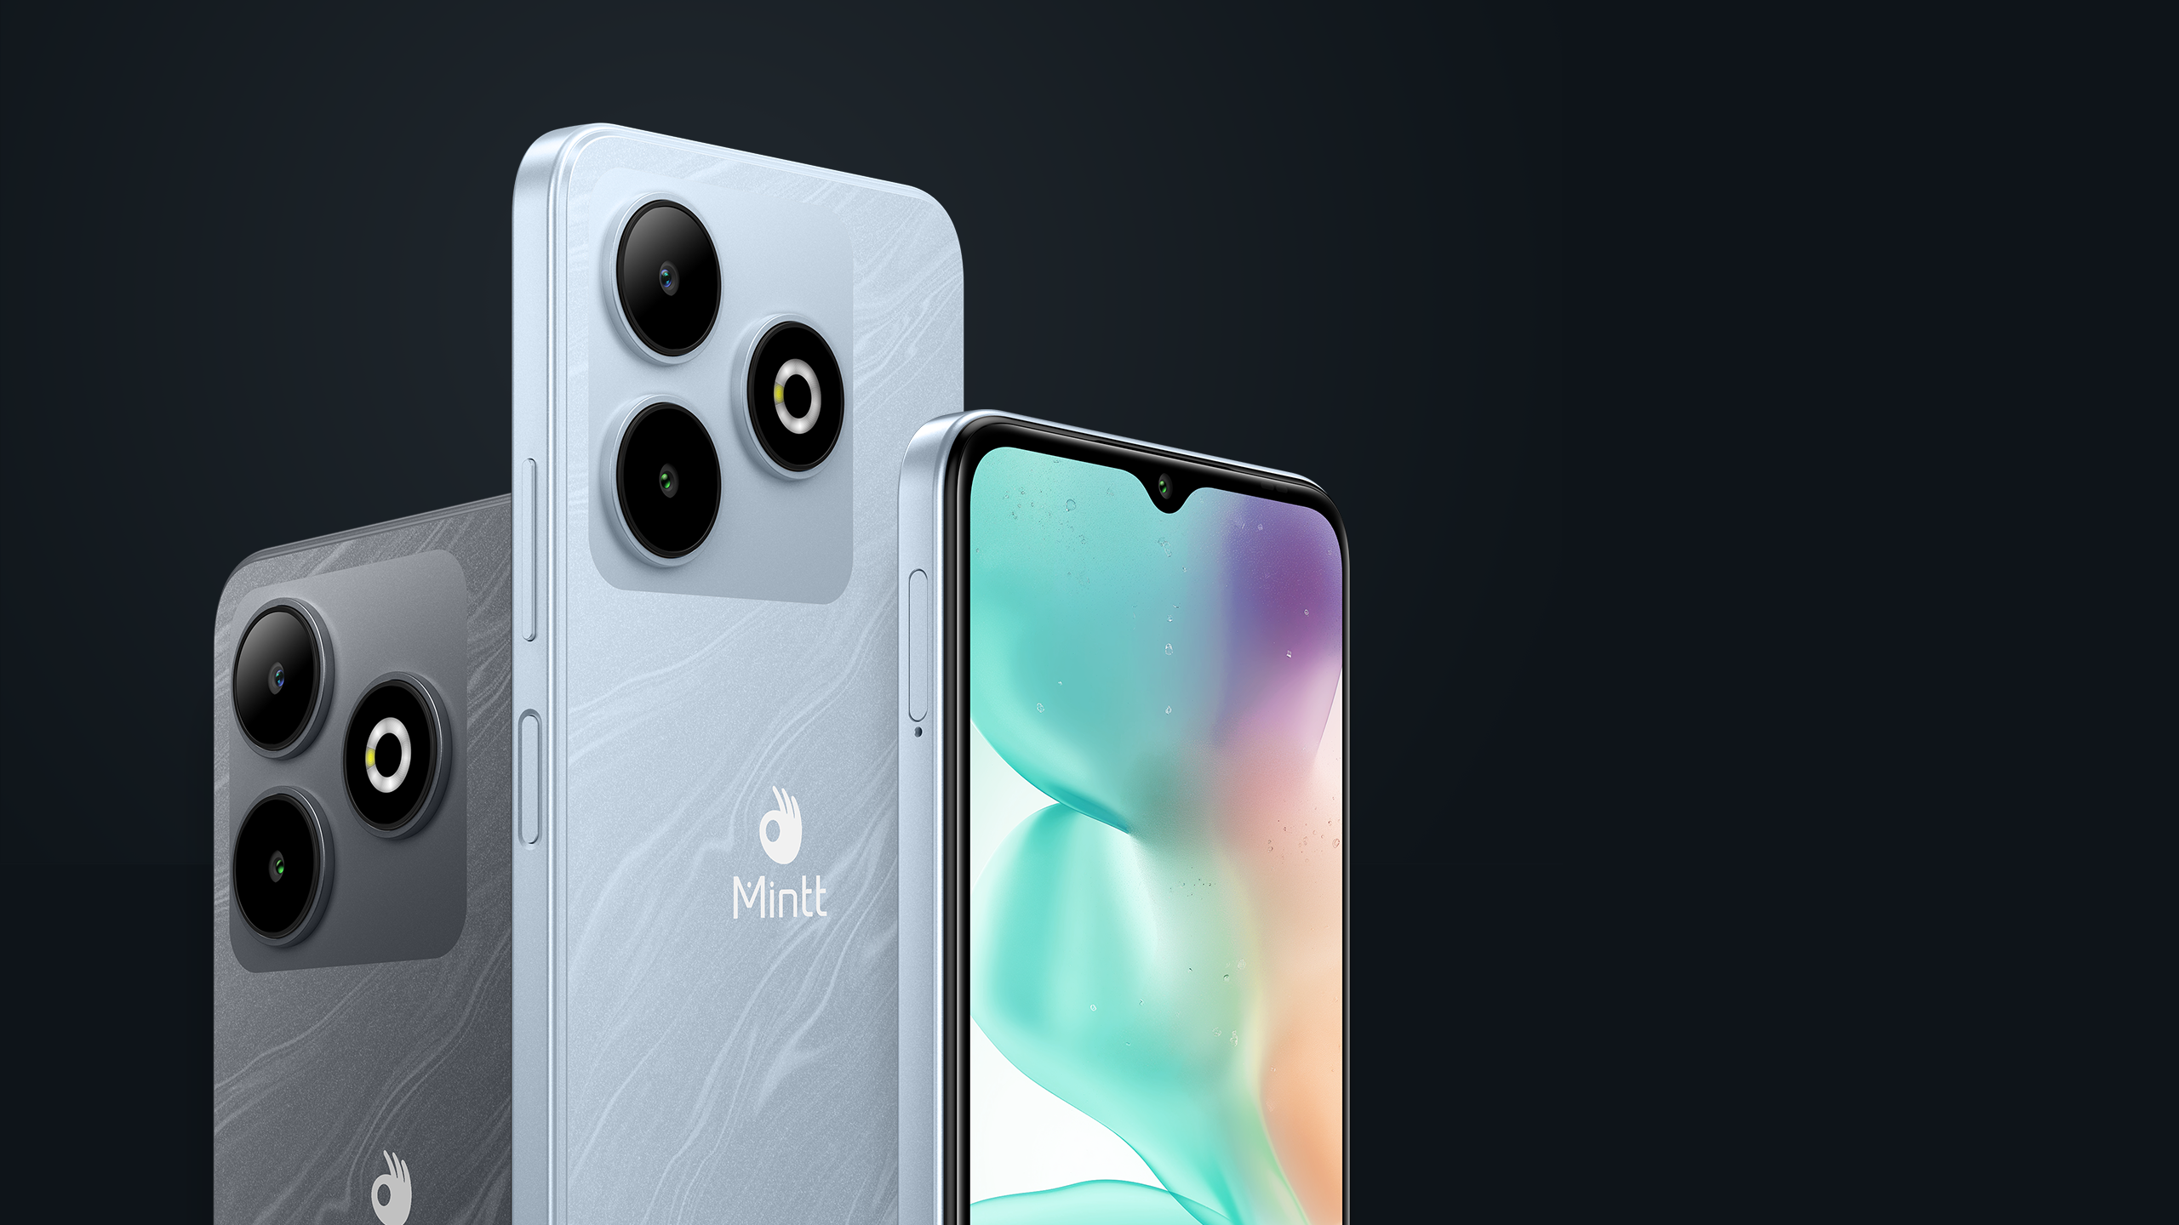
COOLMINTT RIVAL 3
DARE TO
LIVE LIFE
OUT LOUD

Slide 2
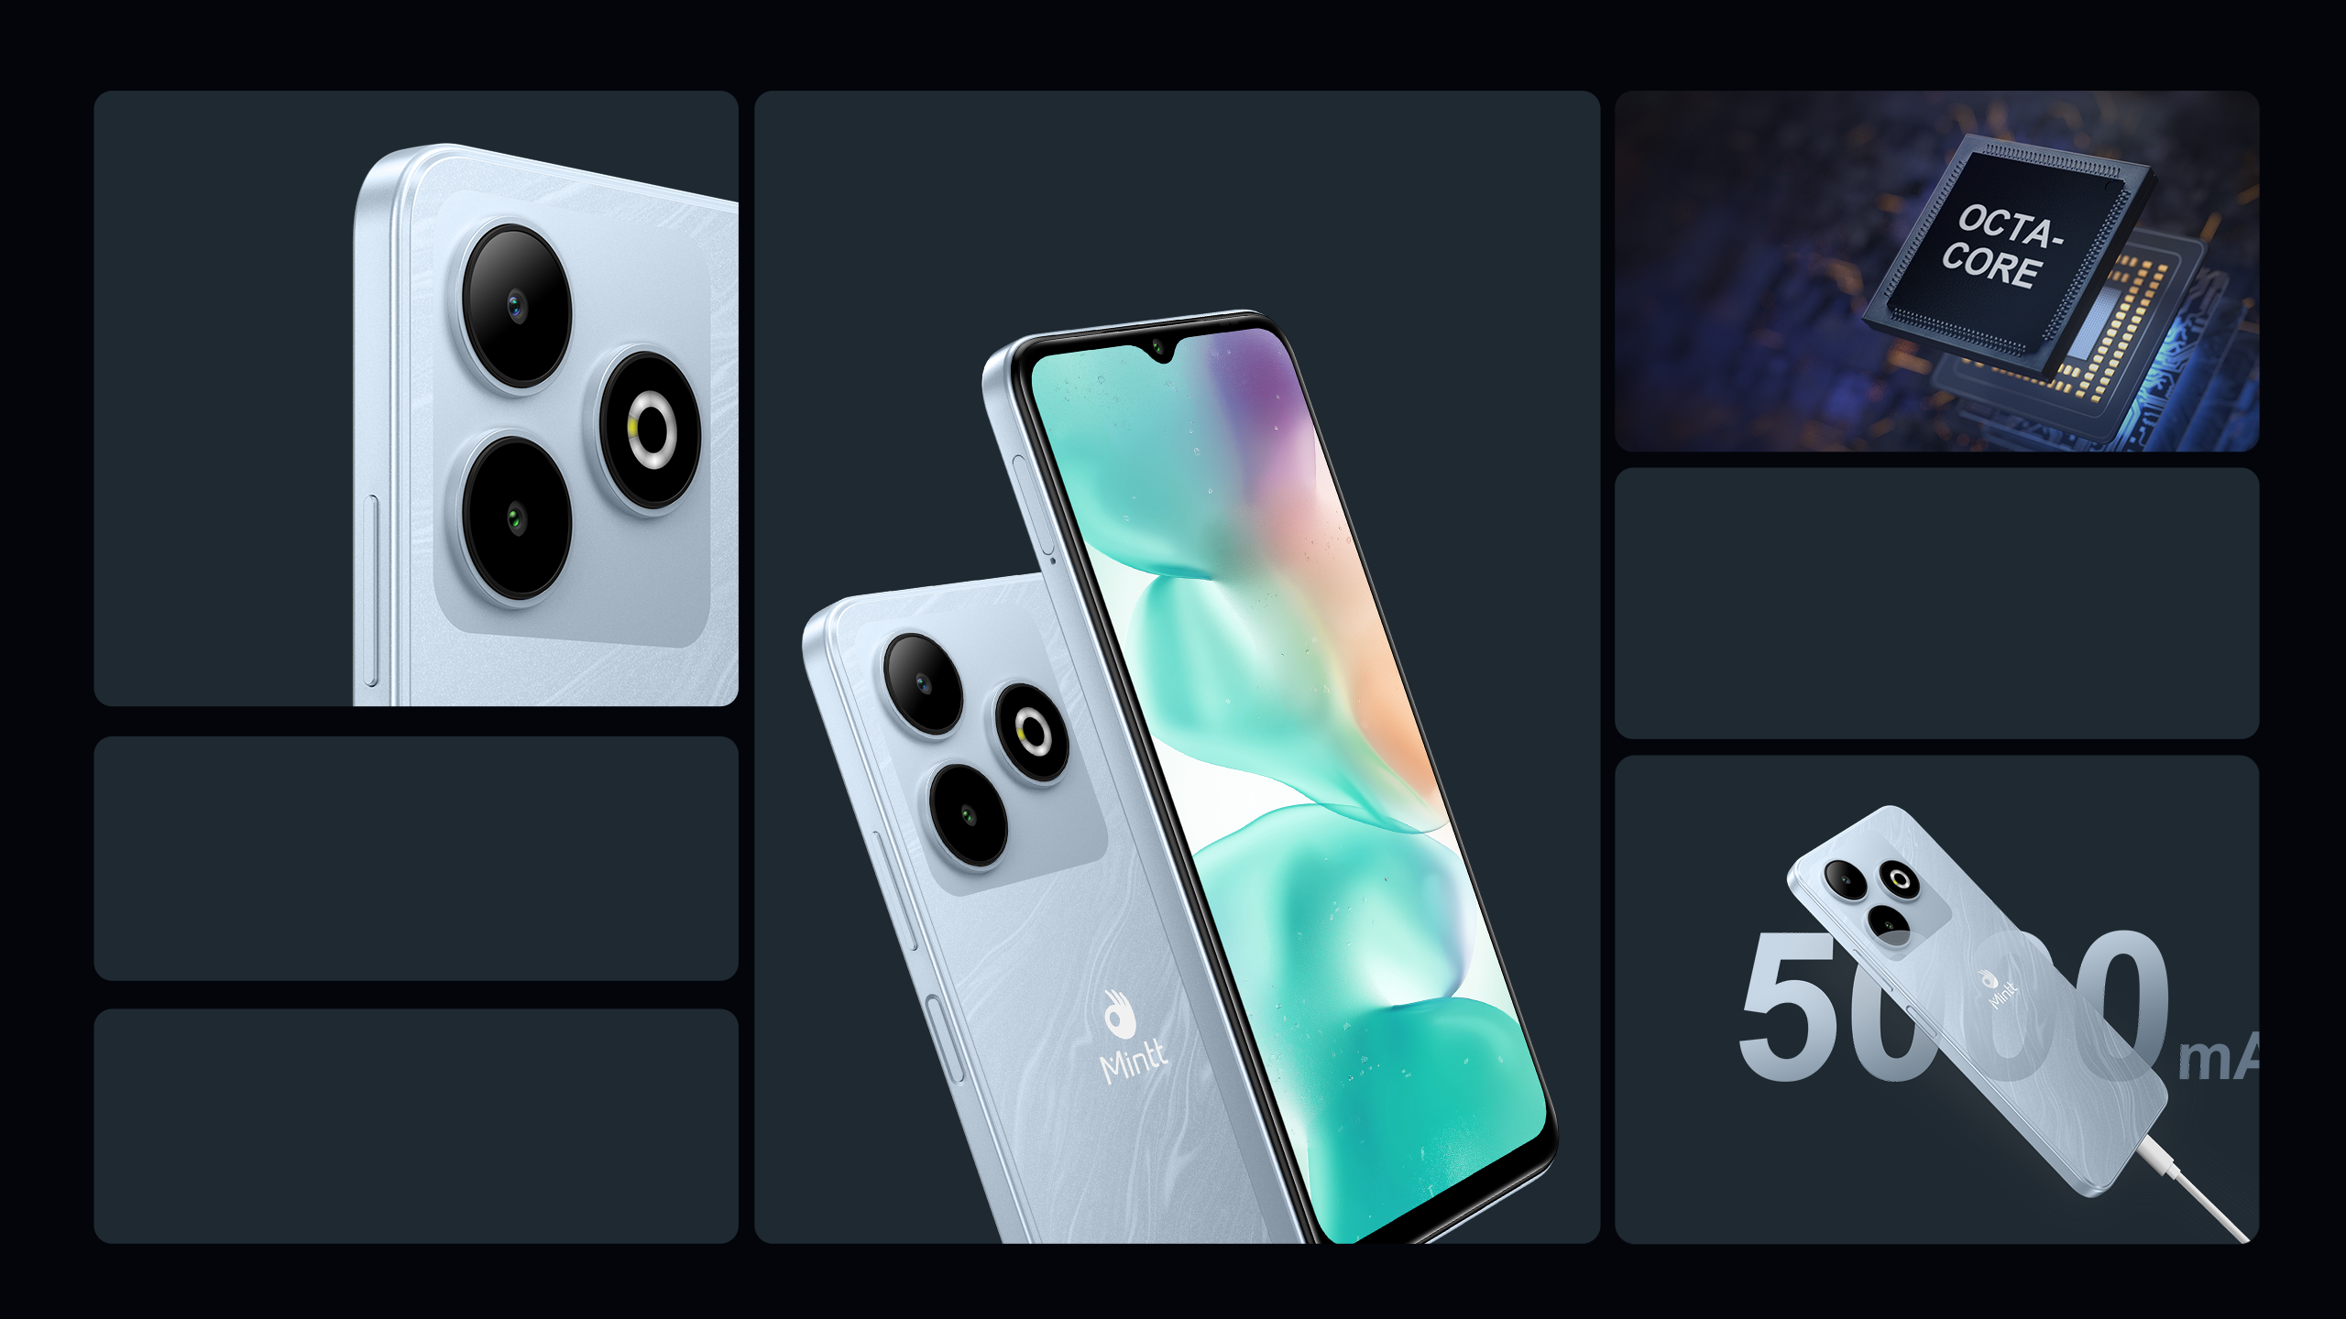

6.56” HD+
Waterdrop Display
SC9863A1
1.6GHz,
Octa-core
13MP
Rear Camera
Android U
5MP
Front Camera
4GB+128GB
Long-lasting Battery Life

Slide 3
Appearance

Slide 4


6.56" HD+ Waterdrop Full Screen
with Outstanding Vision
Large screen and full-screen design make every scene more engaging with improved clarity, High screen-to-body ratio features immersive viewing and a new horizon.
6.56’’ HD+

Slide 5
Performance

Slide 6
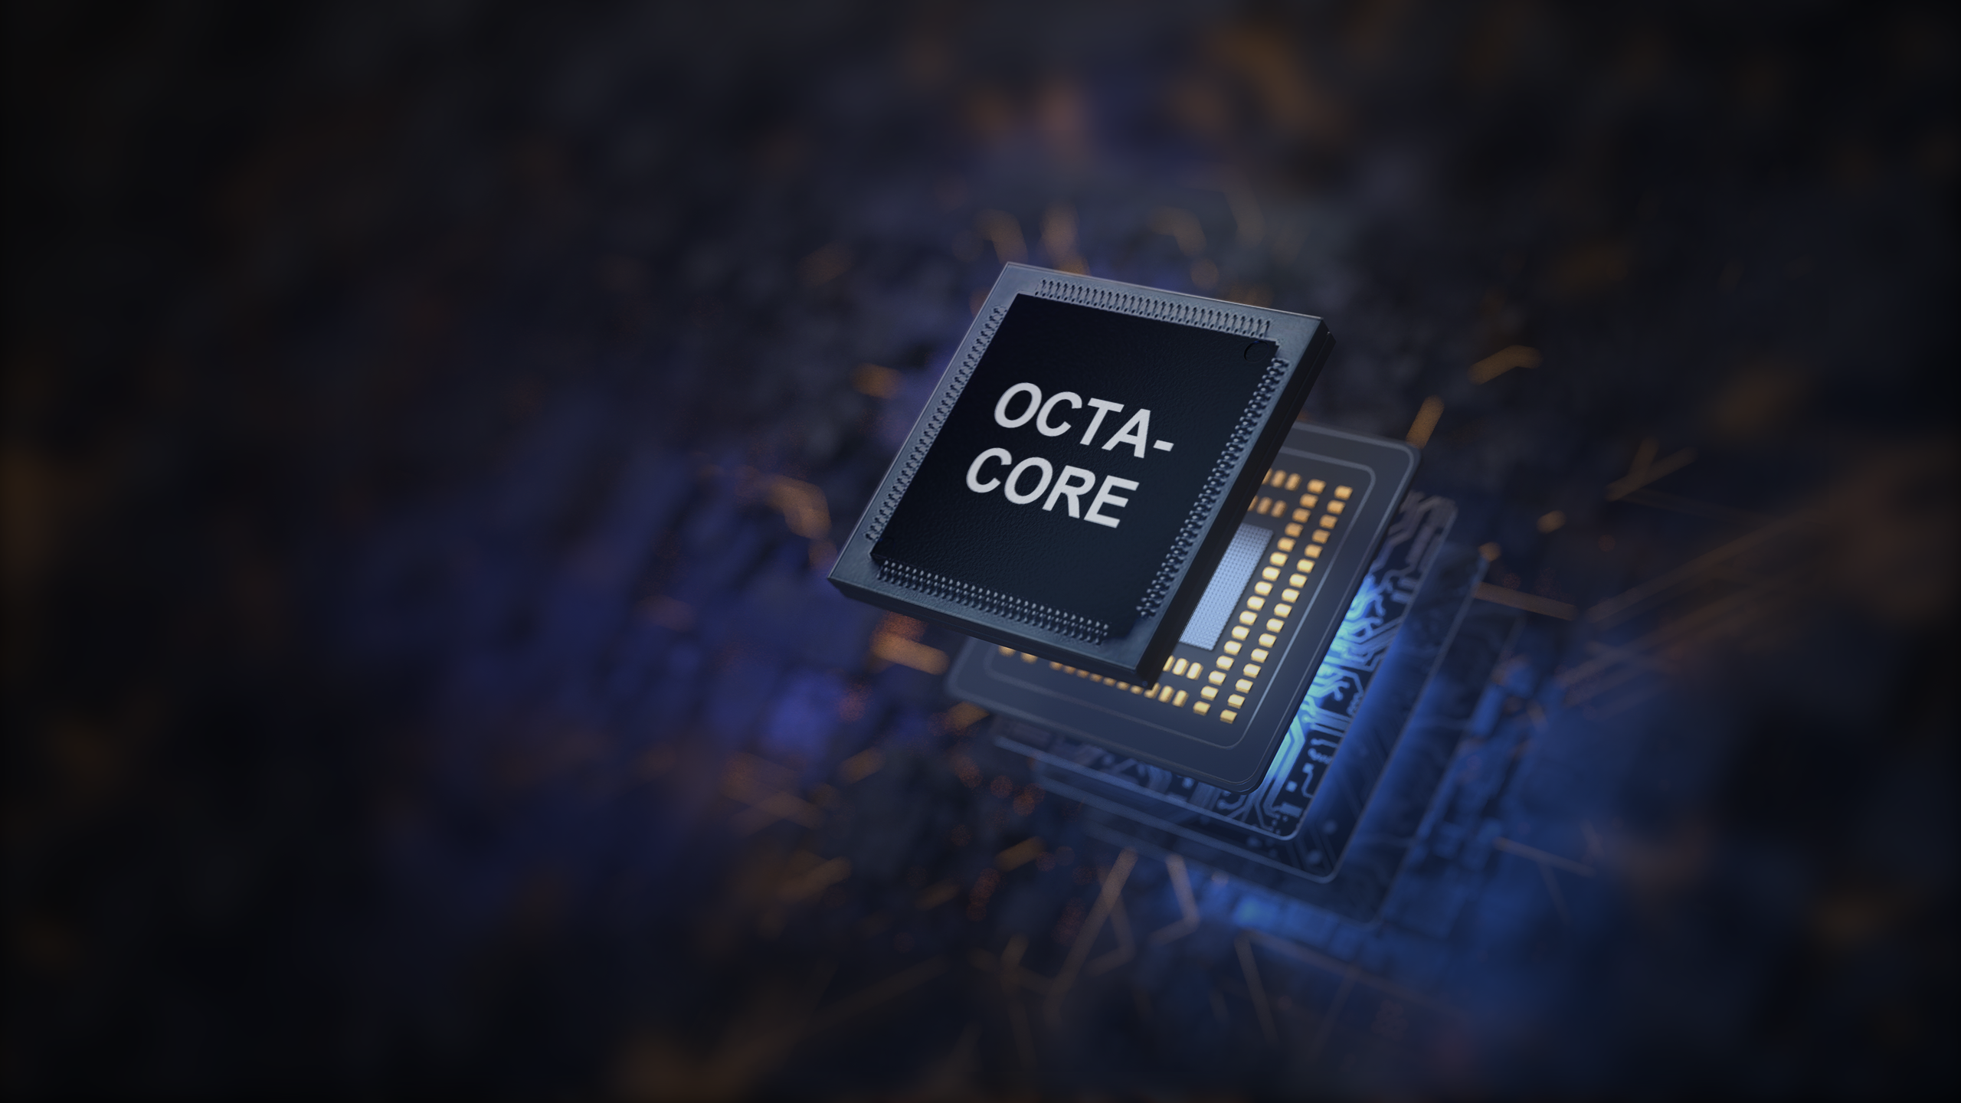
Outstanding Performance
Powerful octa-core processor provide you effortlessly daily use, audio and visual, with 4GB+128GB memory, the seamless and stable operation will become your new normal!
4GB
RAM
128GB
ROM

Slide 7

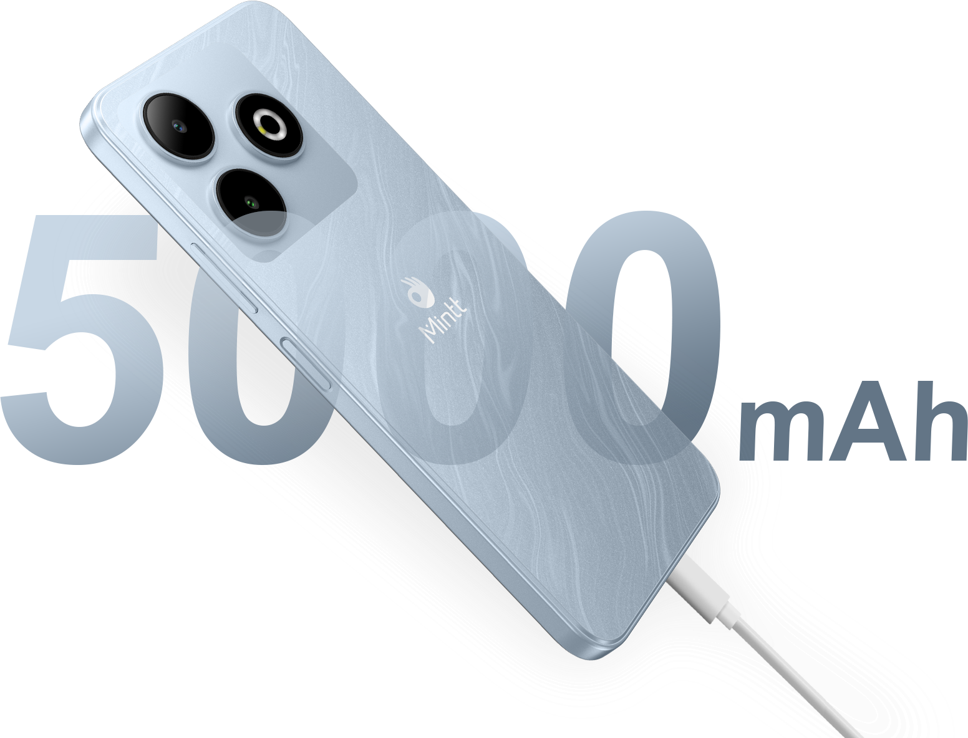
10W Type-C Charging
With advanced power-saving system and ultra battery endurance, saving power intelligently to extend battery life.
Master Long-lasting Battery Life

Slide 8

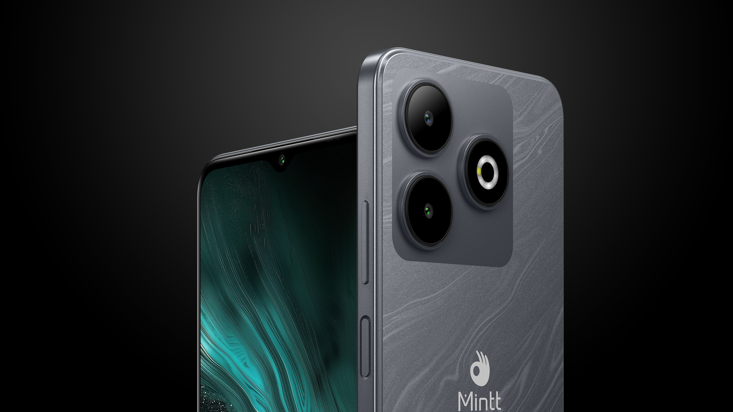
5MP Front
Camera
13MP
Clear Camera

Slide 9

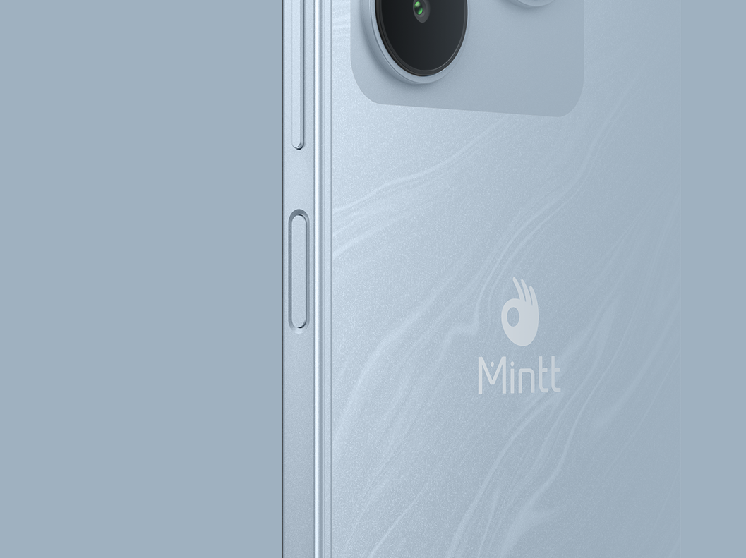
Unlock Your Wonderful Adventure
Face Unlock
at One Glance
Side-mounted
Fingerprint Unlock

Slide 10
Camera configuration

Slide 11
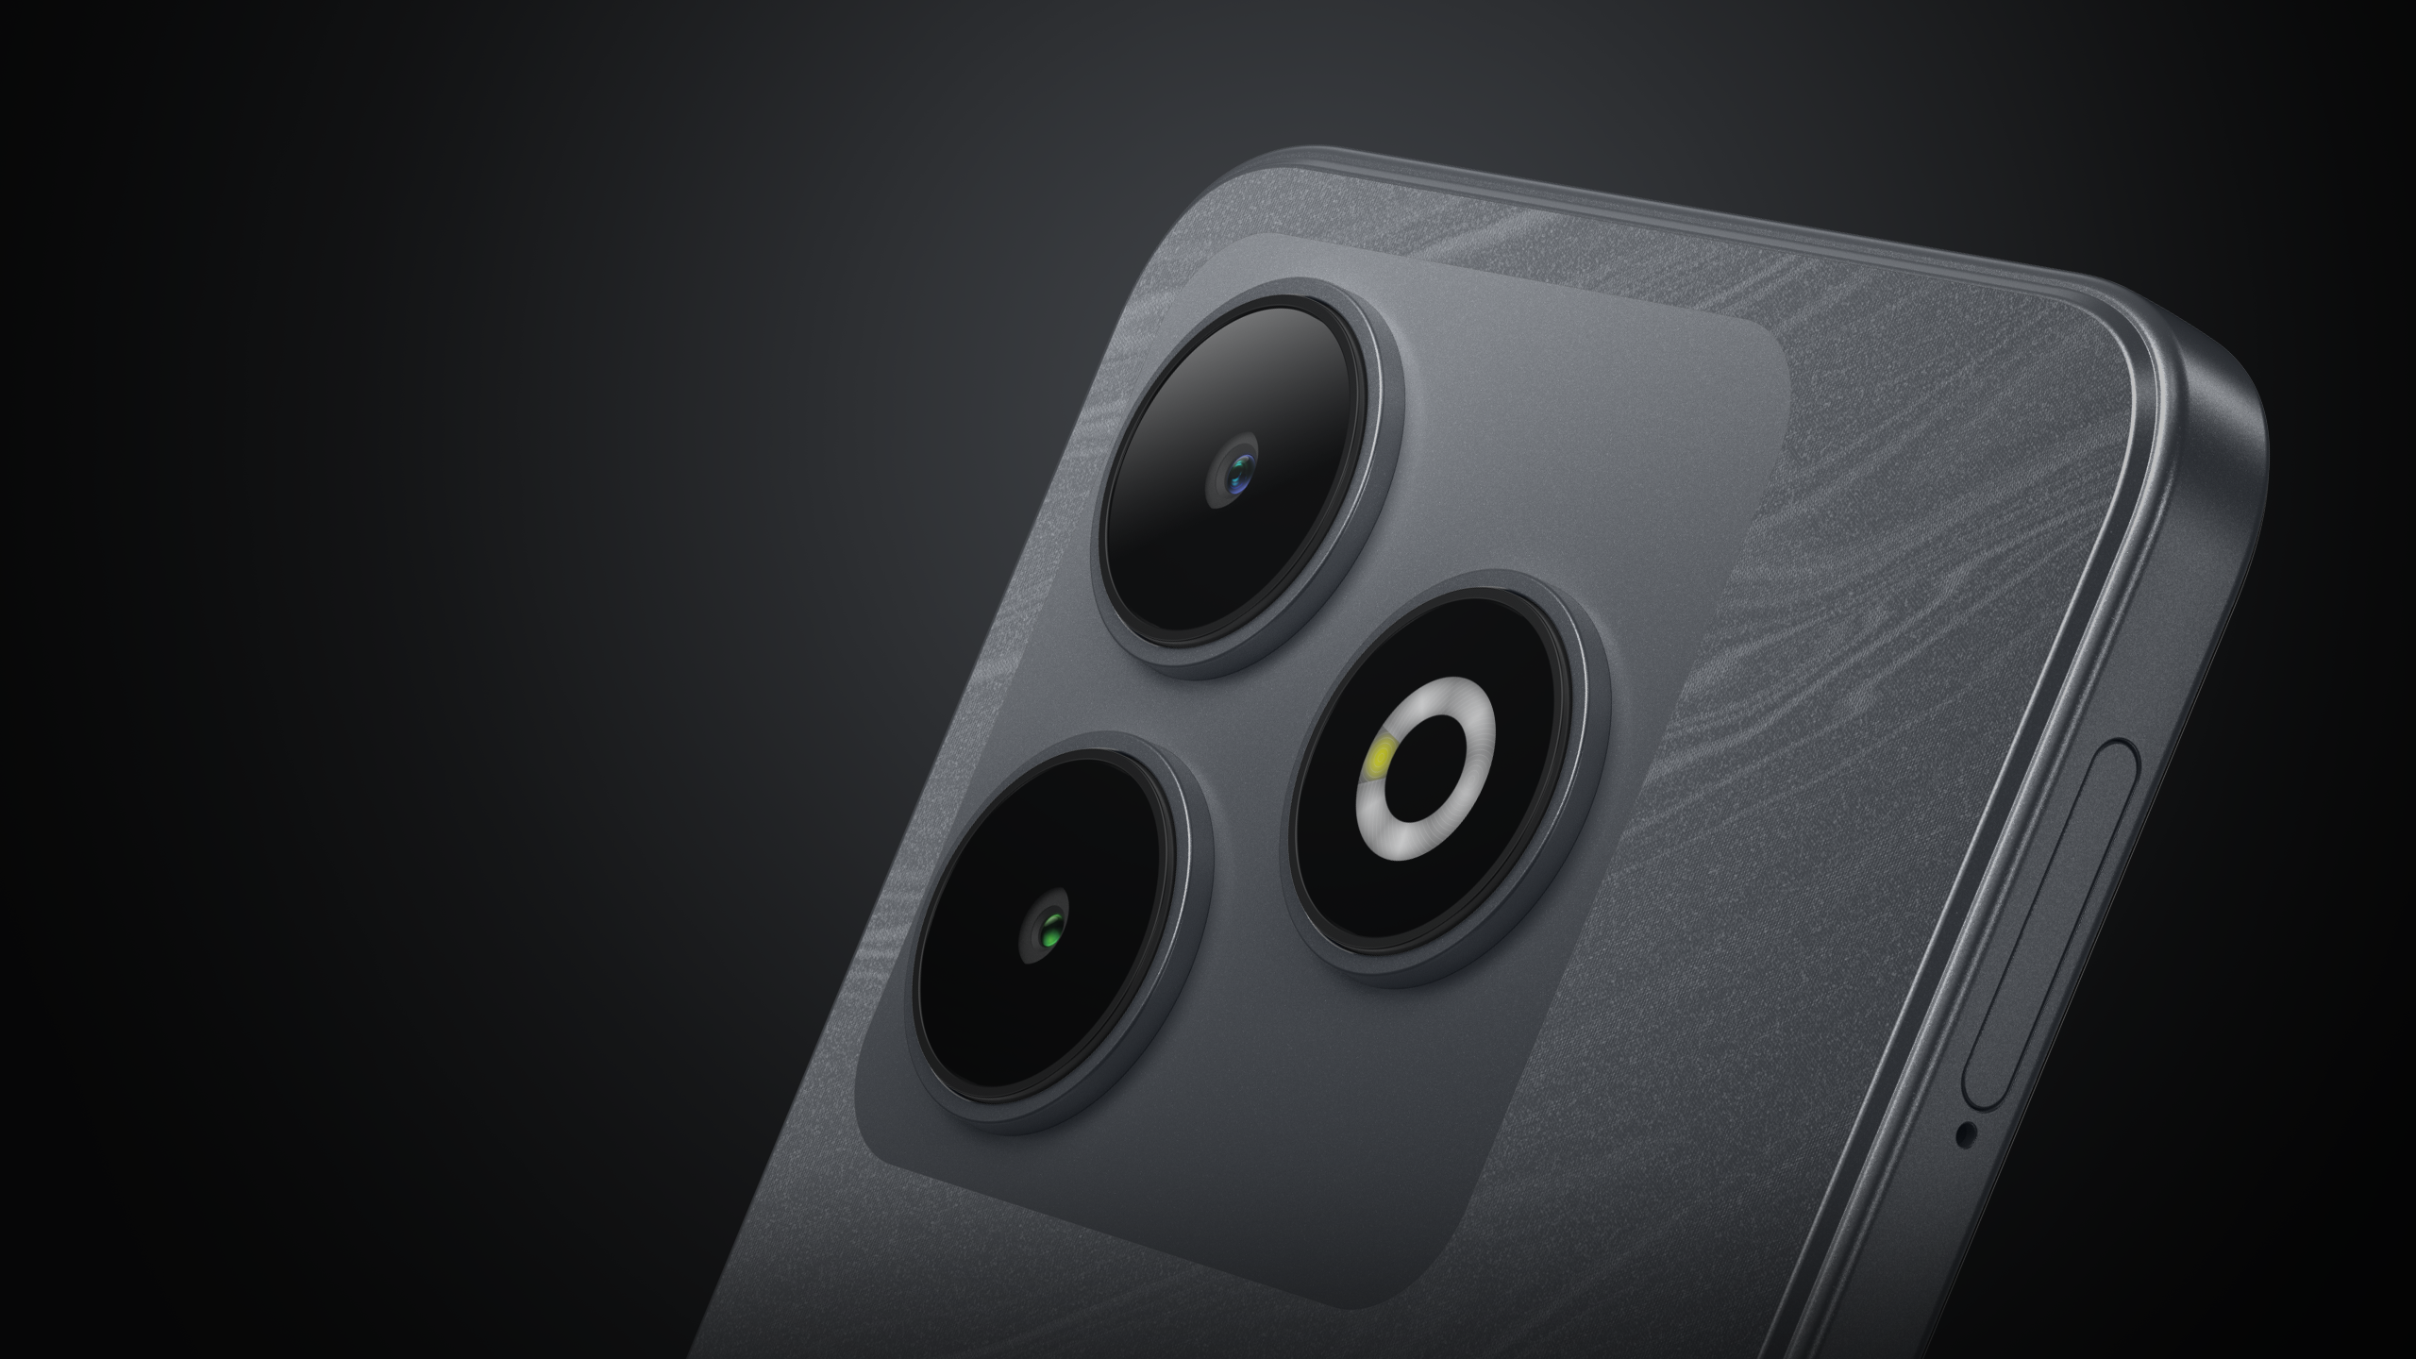
Every Frame Tells a Great Story
With 13MP Rear Camera
Just one tap with COOLMINTT RIVAL 3 rear camera, to frame the unforgettable moments visually, to achieve better shooting effect and present more details.

Slide 12

Discover
Your Real Ego
With 5MP Clear Selfie
Capture more details for clearer selfies, whether outdoors in the sun or in softly lit indoor environments, it can intelligently adjust light and color to ensure your face always looks its best.
The display pictures are simulated images,
which are only used for function description purposes.

Slide 13
Camera key features

Slide 14

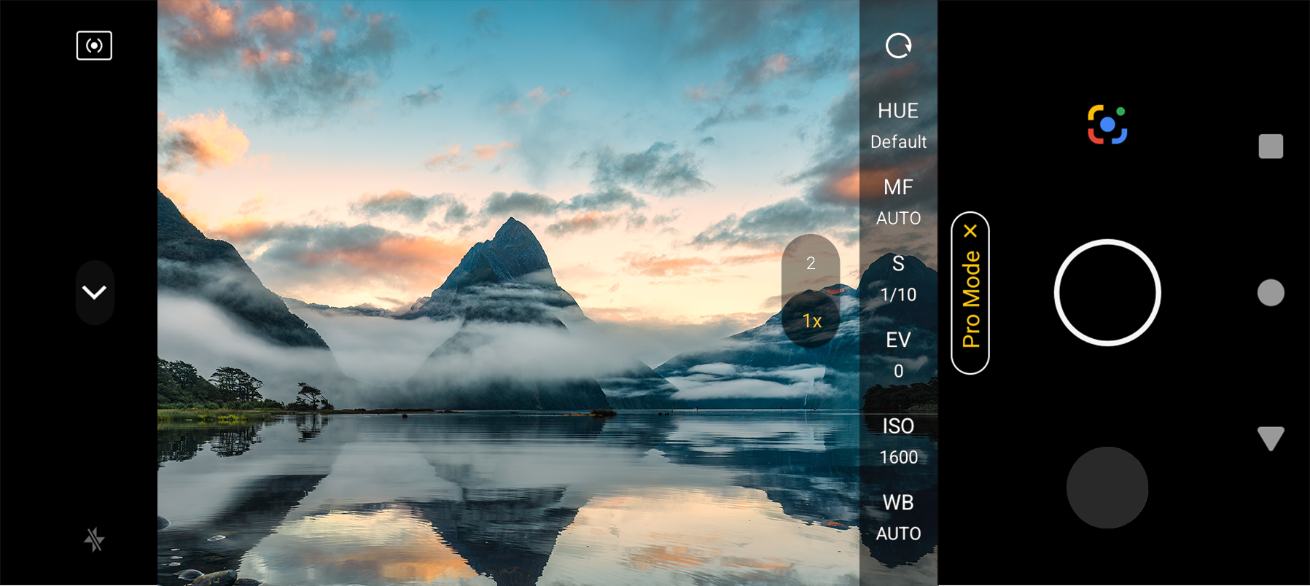
Pro Mode
Pro mode offers you adjustable parameters adjustment, easy to frame the views even in different scenes, delivering a professionals-like shooting experience.
The display pictures are simulated images,
which are only used for function description purposes.

Slide 15













AI Intelligent Scene Recognition
COOLMINTT RIVAL 3 upgraded AI mode, add dog, cat, text scenarios, easy to intelligently recognize 12 independent scenarios. AI Mode will make exclusive optimization for different scenarios, to produce rich-colored and photo-realist style.

Slide 16

Night Master
Shooting at night is even better
On
Off

Slide 17

Time Lapse
The time-lapse function allows you to condense a long period of change into a short video, using images to record natural wonders such as the blooming and falling of flowers, the rising and setting of the sun and the moon, showing the magnificence and delicacy of the passage of time.

Slide 18
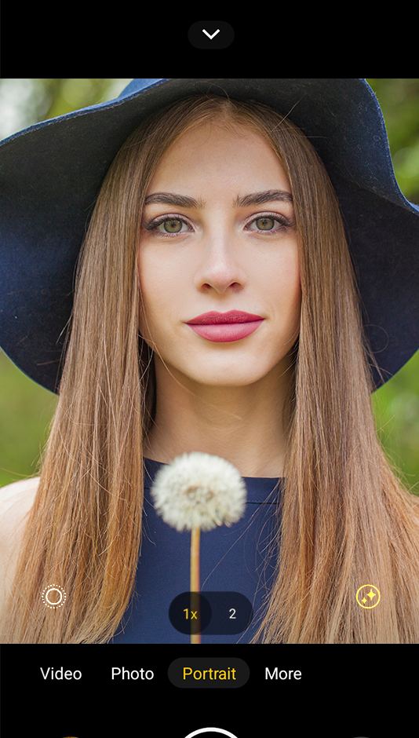
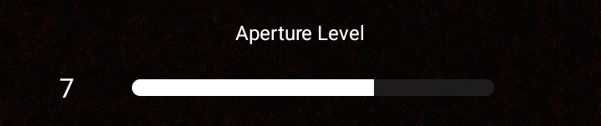
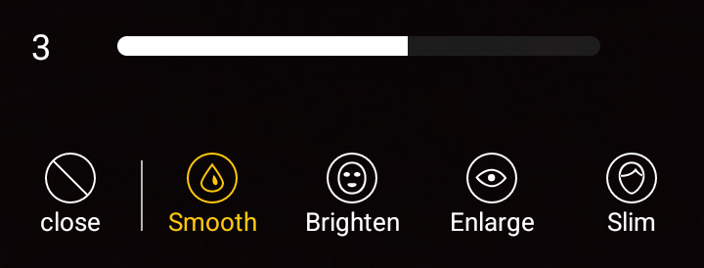
Snap the Best of You
Adjust aperture and beauty level as you like

Slide 19
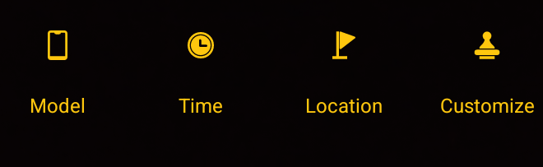

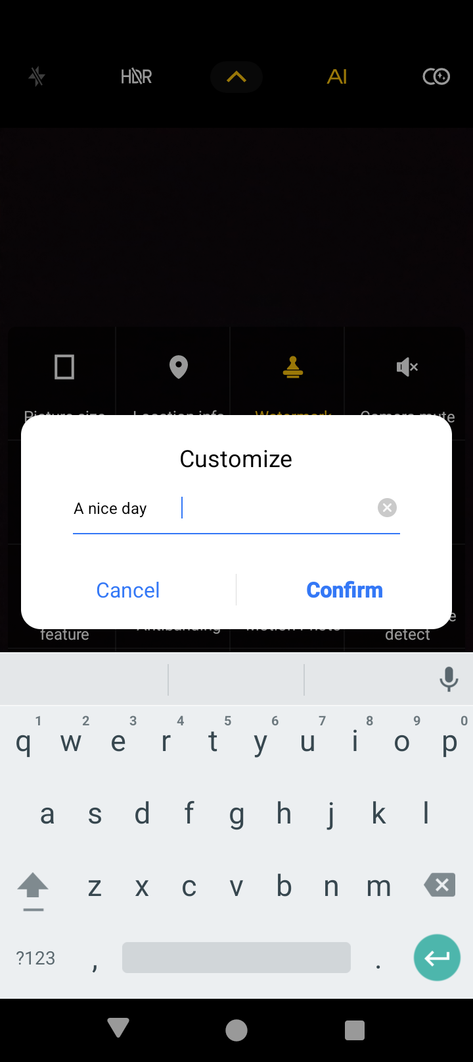

Customized Watermark
Edit the watermark with your mood, help you record every bit of daily life.
COOLMINTT RIVAL 3 ·A nice day
2024.09.13.10:31
The display pictures are simulated images,
which are only used for function description purposes.

Slide 20

Panorama

Slide 21

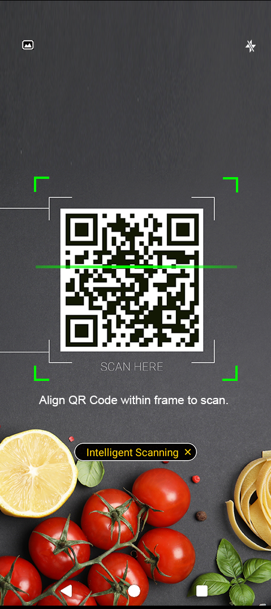

Intelligent Scan
The camera will mark the QR code in the scan box, making it easier to scan.

Slide 22

Smoother, Smarter and more Power-saving

Slide 23
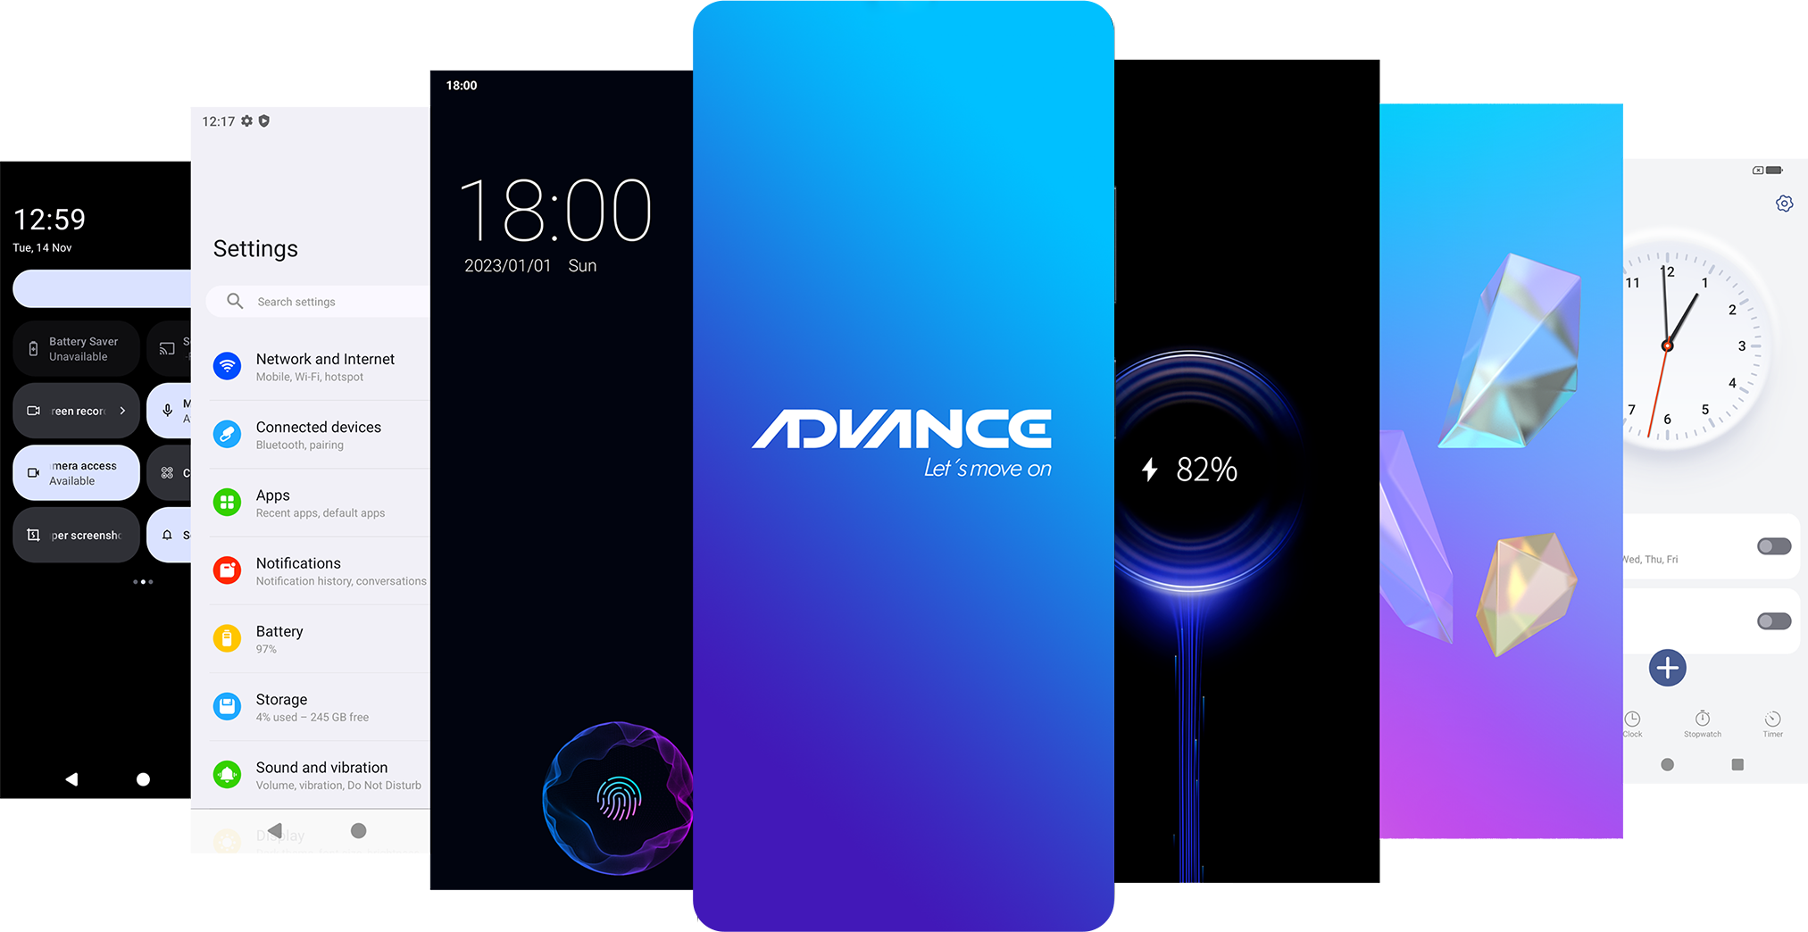
10+Module Customization

Slide 24

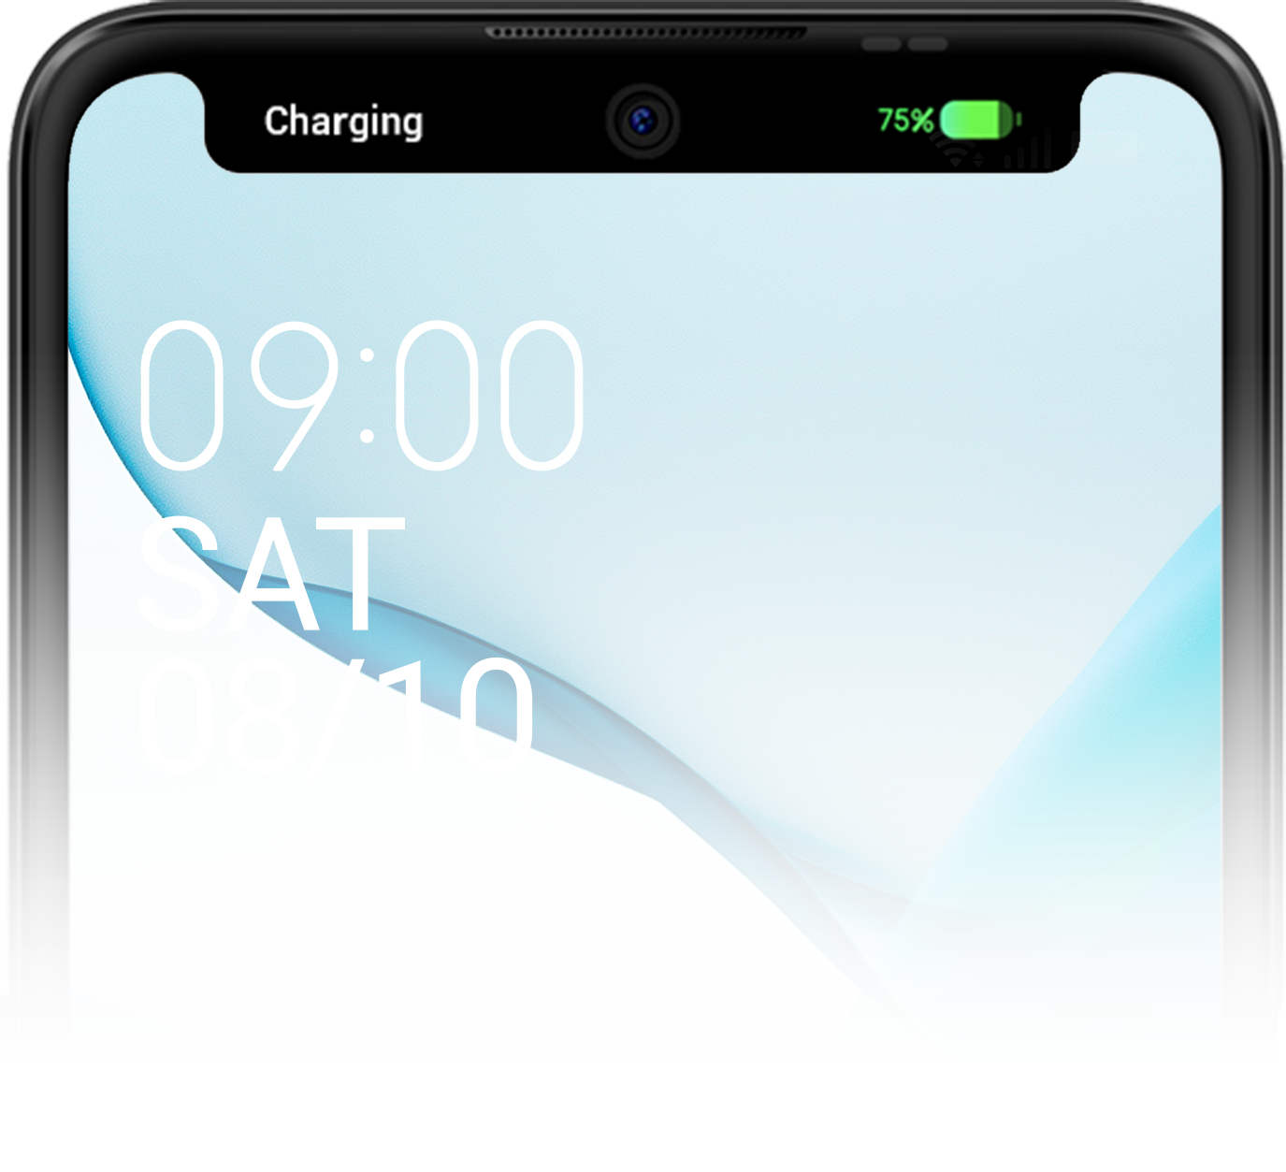


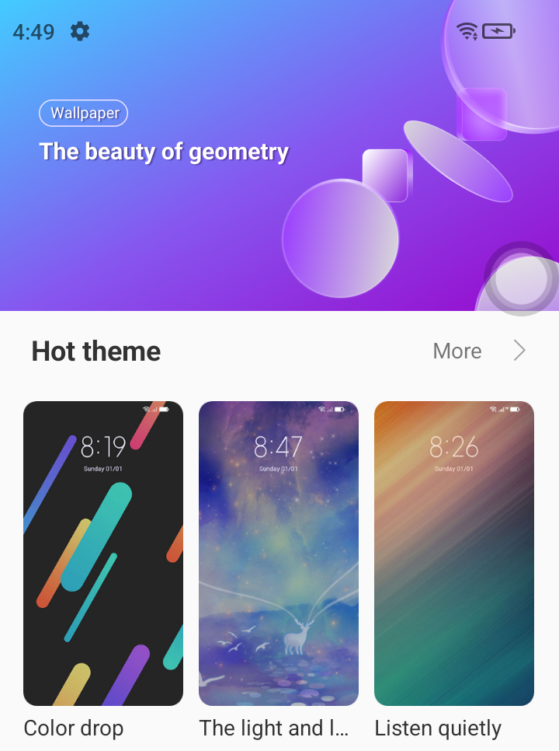
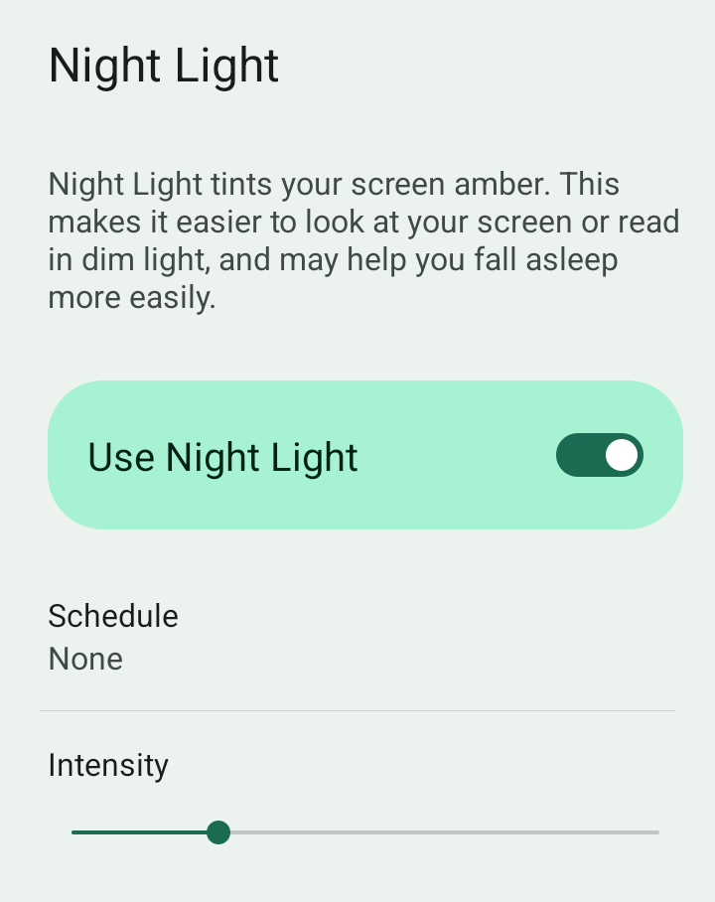
Listening Mode
Dynamic Capsule
The listening mode developed for the popular app YouTube can continue to listen in the form of sound when the App returns to the background or the screen is off.
It can be used in seven scenarios: calls, music, sound status, timer, radio, charging, and recording.
Rich Theme Store
To choose or customize special color and element.
Night light
Make it easier to look at your screen or read in dim light, and may help you fall asleep more easily.

Slide 25
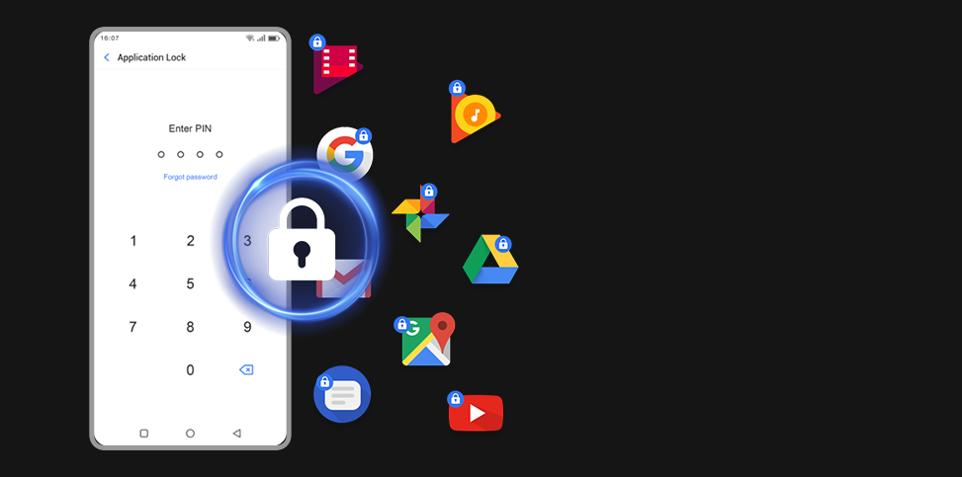
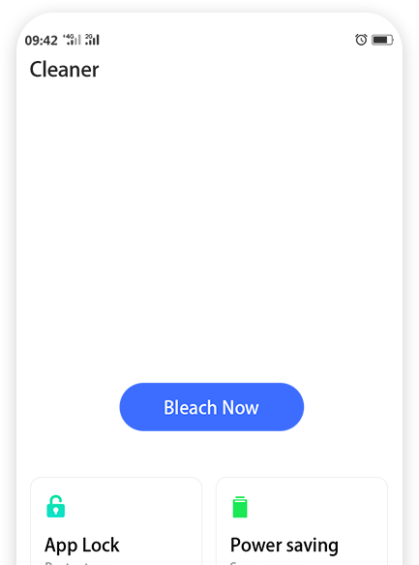
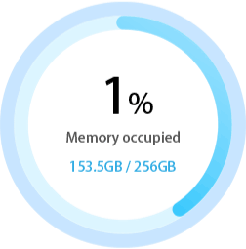
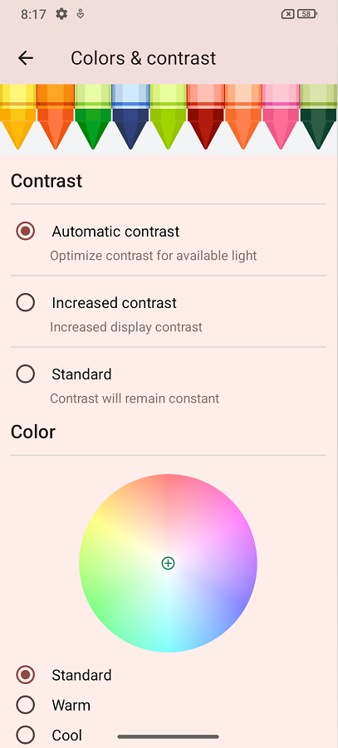
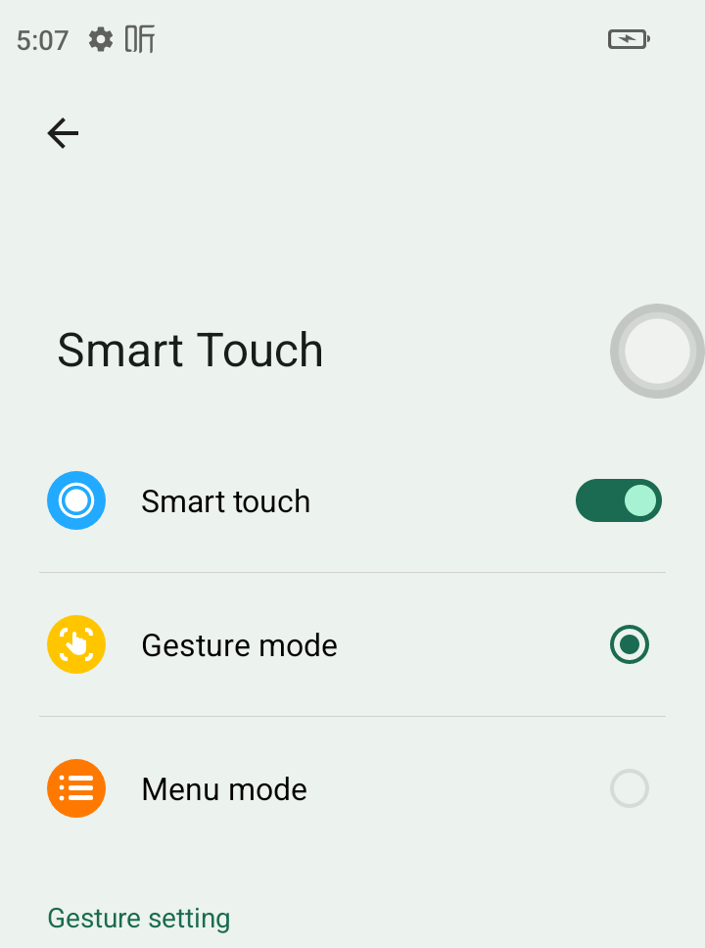
Lock the apps
Cleaner
Protect your privacy
Make your phone less "burdened" and operate more smoothly
Customized color temperature adjustment
Smart touch
The floating button opens shortcut functions for easy one-handed operation.
Freely adjust the temperature of the screen

Slide 26


Slide 27
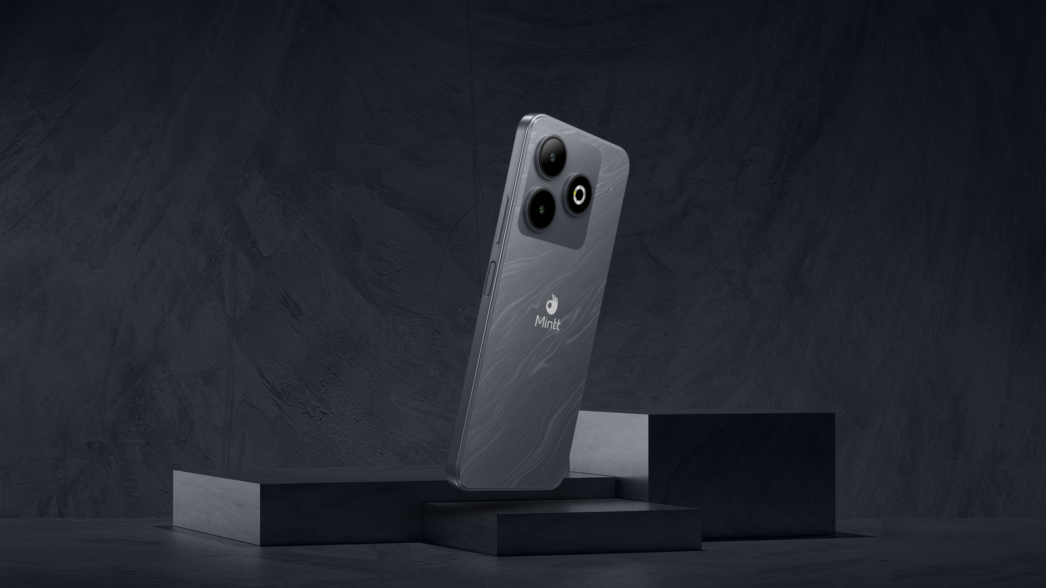

Slide 28
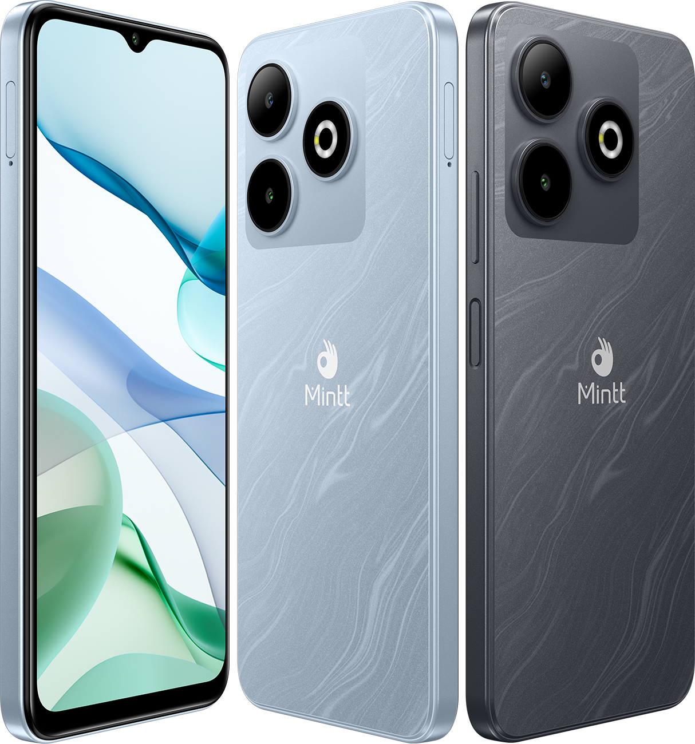
COOLMINTT RIVAL 3 Specifications
Display | 6.56’’ HD+ Waterdrop Display
Battery | 5000mAh, Type-C charging
Camera | 5MP Front Camera 13MP Rear Camera
Processor | SC9863A1 1.6GHz, Octa-core
Memory | 4GB+128GB
System | Android U
Dimension | 164.3*75.83*8.79mm
SIM | 4G, nano+nano+TF
WIFI | 2.4GHz 802.11b/g/n
Bluetooth | BT4.2
Network | GSM:2/3/5/8 WCDMA:1/2/5/8 FDD:1/2/3/5/7/8/20/28AB TDD:38/40/41

